Slide 1
SQL QUERY TABLES
Here are screenshots of answering questions using SQL queries from related tables. The related SQL and text files show all of the queries.

Slide 2
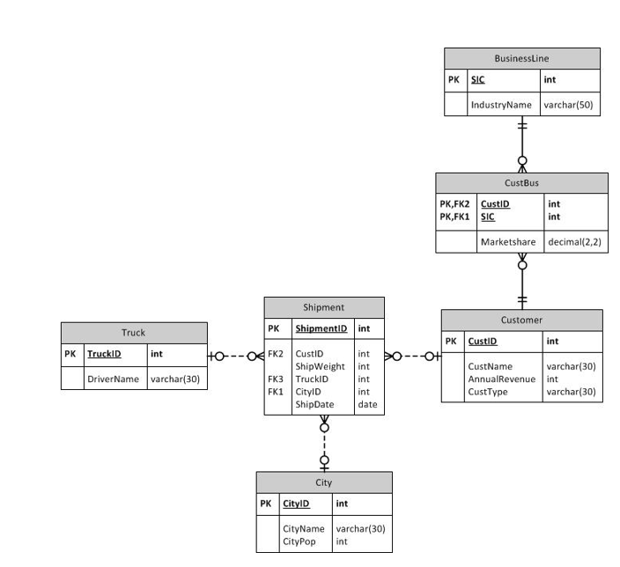
ERD
This is the ERD used to understand the relationships between the tables on slides 3-5

Slide 3
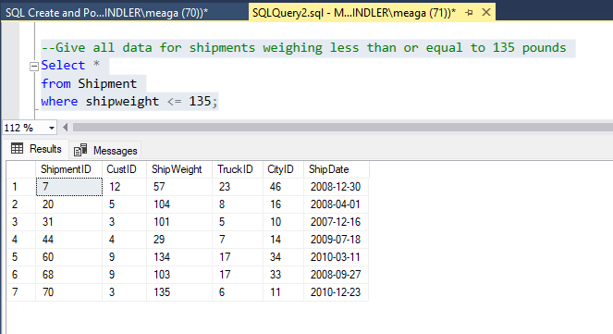

Slide 4
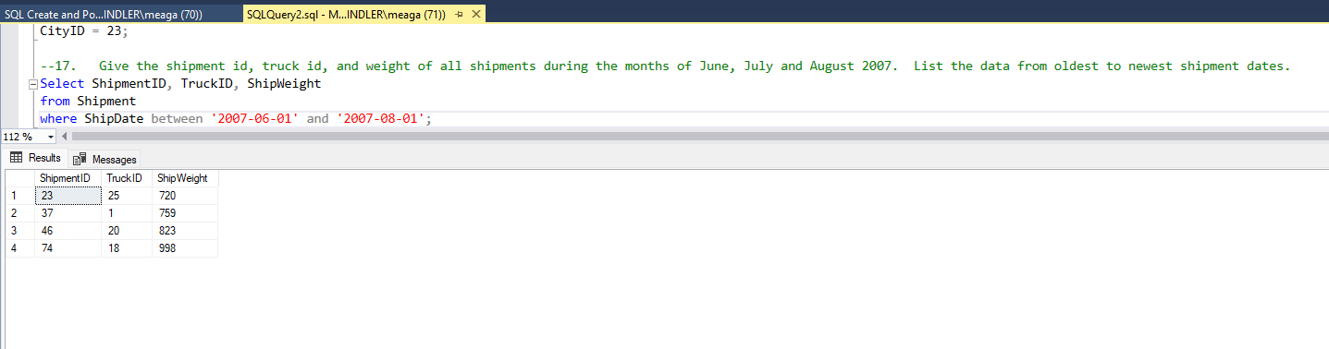

Slide 5
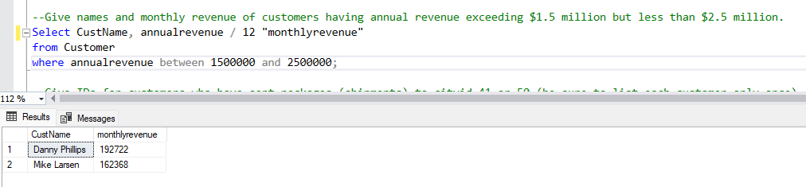

Slide 6
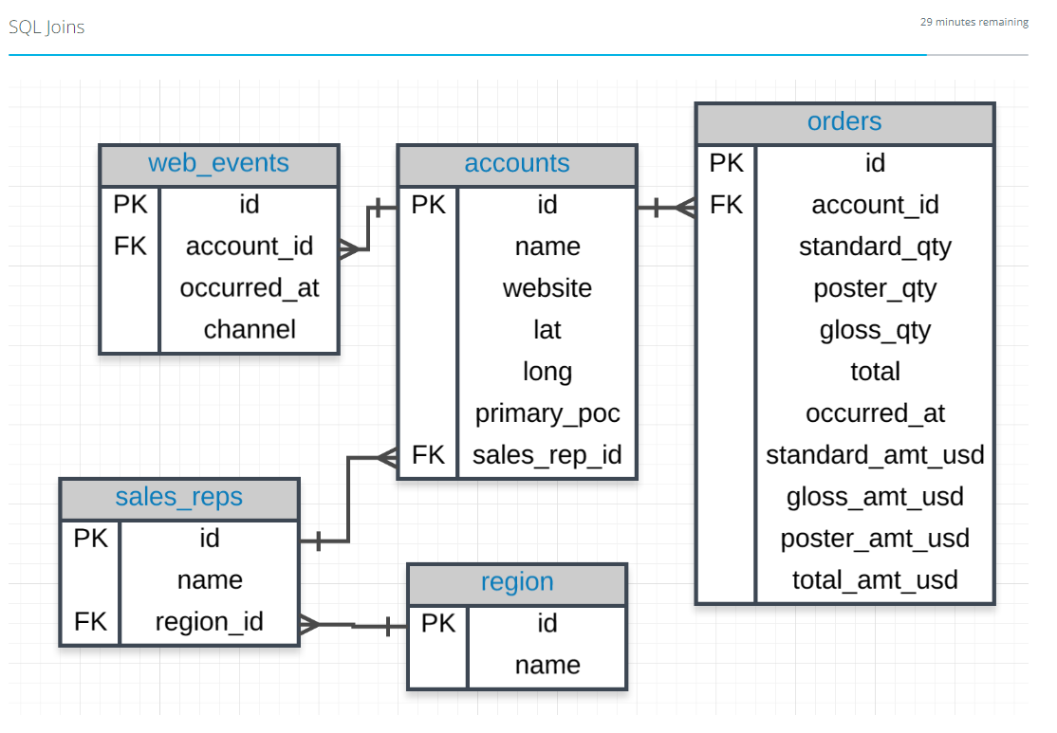
ERD
This ERD is used to understand the relationships between the tables for slides 7-9

Slide 7
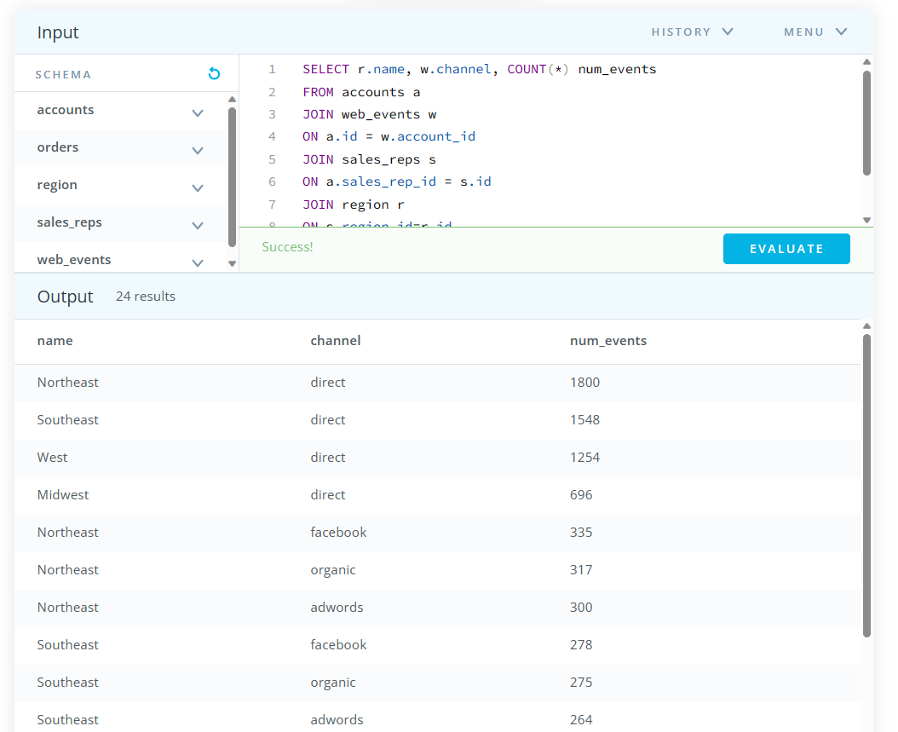
Question: Determine the number of times a particular channel was used in the web_events table for each sales rep. Your final table should have three columns - the name of the sales rep, the channel, and the number of occurrences. Order your table with the highest number of occurrences first.

Slide 8
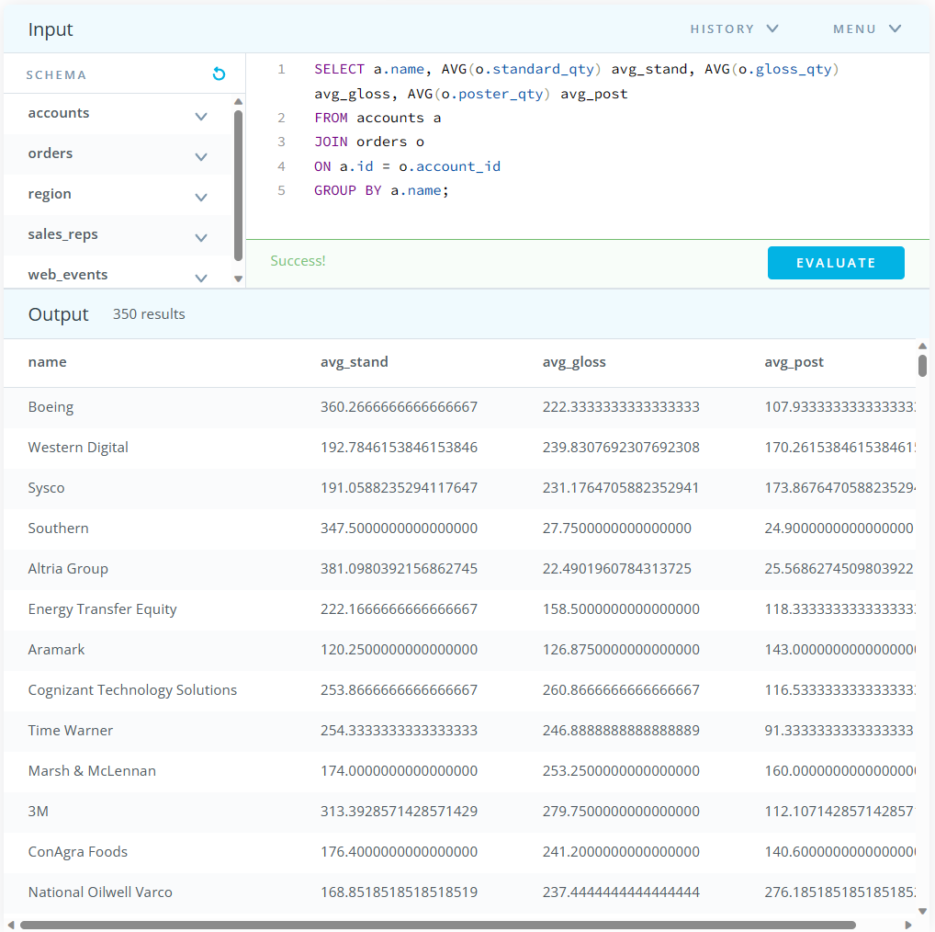
Question: For each account, determine the average amount of each type of paper they purchased across their orders. Your result should have four columns - one for the account name and one for the average spent on each of the paper types.

Slide 9
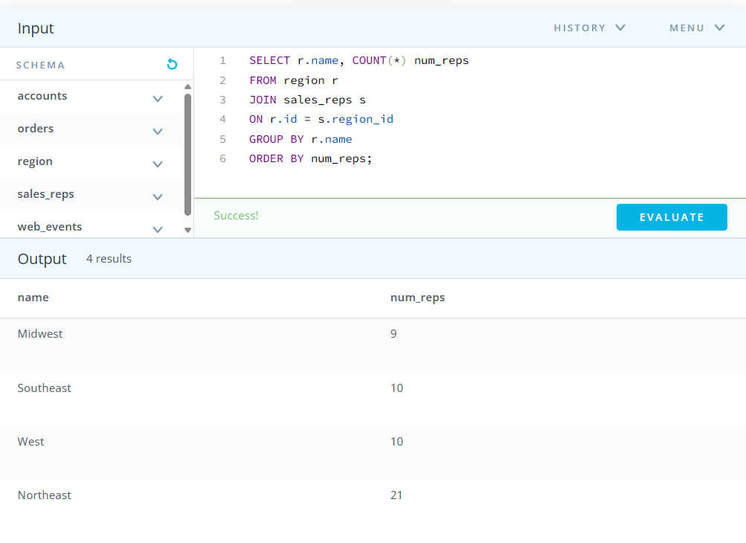
Question: Find the number of sales reps in each region. Your final table should have two columns - the region and the number of sales_reps. Order from fewest reps to most reps.

